Slide 1

MINOR PROJECT - II ON ATYPICAL:STOCK IMAGE SITE (MCA – II SEMESTER; BATCH 2021-23)
Internal Guide
Dr. Sunil Pratap Singh (Asst. Prof., BVICAM, New Delhi)
Presentation by
Gagandeep Singh
Vaibhav Baweja Tanu Soni
Date of Presentation
Notes:
1

Slide 2
Contents
Problem Description
Aim and Objectives
Methodology and Technology Used for Project Development
Project Modules and My Role
Design Documents (Use Case, Data Flow Diagram, Entity-Relation Diagram, etc.)
Screenshots
Testing of Project
Conclusion
Future Scope
Bibliography

Slide 3
Problem Description
Atypical is a Web App where Users can download pictures publically for free without any hassle.
It’s made for people like Graphic Designers, Artists, Content Creators who can search images which need in their work and can download them for free. Images can be posted by anyone after creating an account on Atypical by Signing up.
It’s clean and elegant design helps people to use it conveniently. People can find images by going through the Categories assigned right after the image is uploaded to the server.
It’s responsiveness enables it to be platform independent which simply means Users can conviniently access the whole site with their Computers and Smartphones. Users can upvote and downvote images which they like or dislike for giving feedback to the person who uploaded it.

Slide 4
Aim and Objectives
Aim:
To develop a web-based application for uploading and categorizing stock images
Objectives:
The main objective of Atypical is to give Artists and Photographers a platform to share their images to the world so that they can download them for free.
Images are Categorized right after they are uploaded which enables everyone to discover their content in no time. People need to have an account on Atypical to Upload Images. That account also gives them ability to Upvote and Downvote images for feedback.
In this application, all the Uploads are handled by Everypixel’s API which categorizes images and makes them searchable.

Slide 5
Methodology and Technology Used
Methodology used for Project Development:
Waterfall Model of SDLC
Technology used for Project Development:
Front-End: HTML 5.0, CSS 3.0, Bootstrap 4.0,Javascript ES6
Back-End: Flask
Integrated Development Environment (IDE): VS Code, Visual Studio 2019
Database: MongoDB,
Web Server: Glass Fish 3.0

Slide 6
Project Modules and My Role
Project Modules:
Order Management
Customer Management
My Role in the Project:
Design of Web Forms (User Interface)
Design of Database Schema
Development of Business Logic
Testing (Unit Testing and Integration Testing)
If Required

Slide 7
System Design

Slide 8
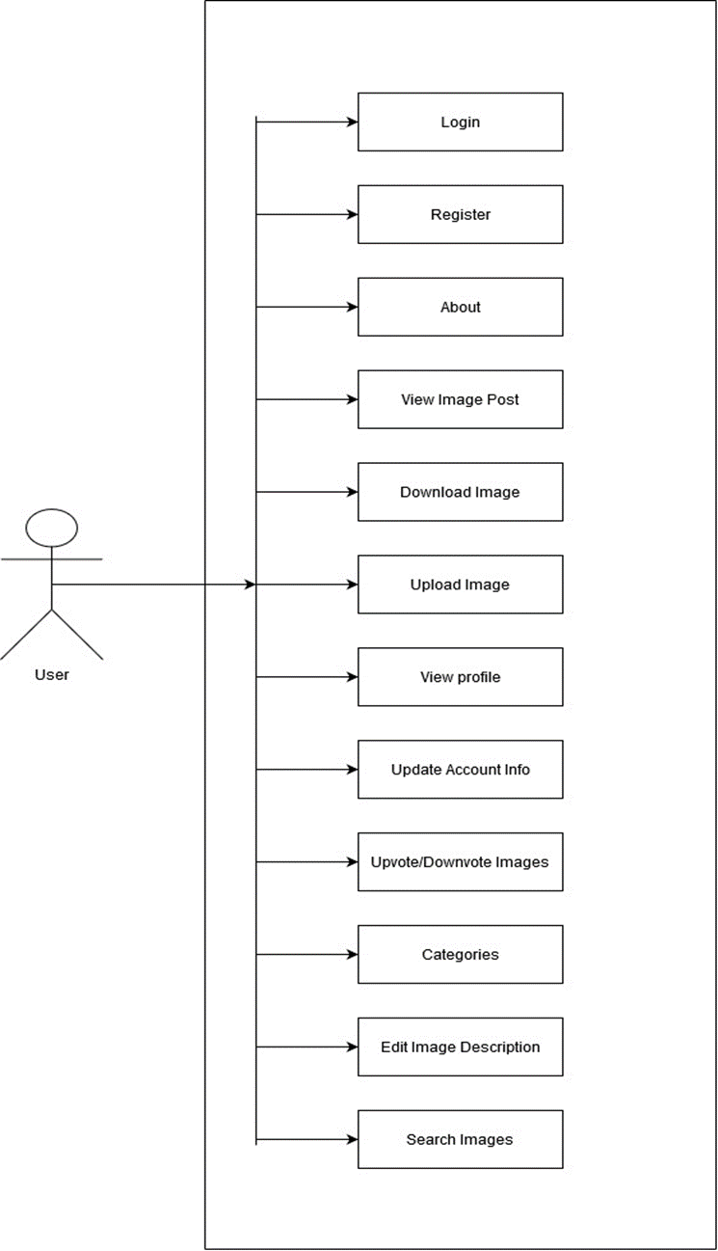
Use Case Diagram

Slide 9
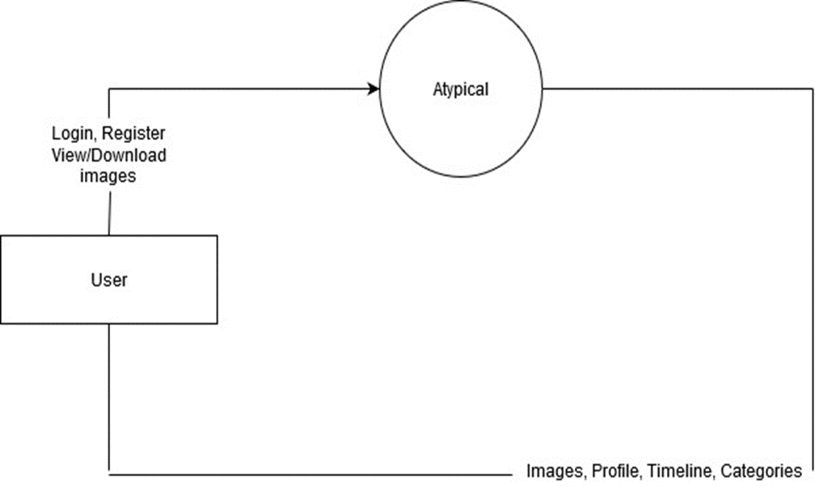
Data Flow Diagram (Level - 0)

Slide 10
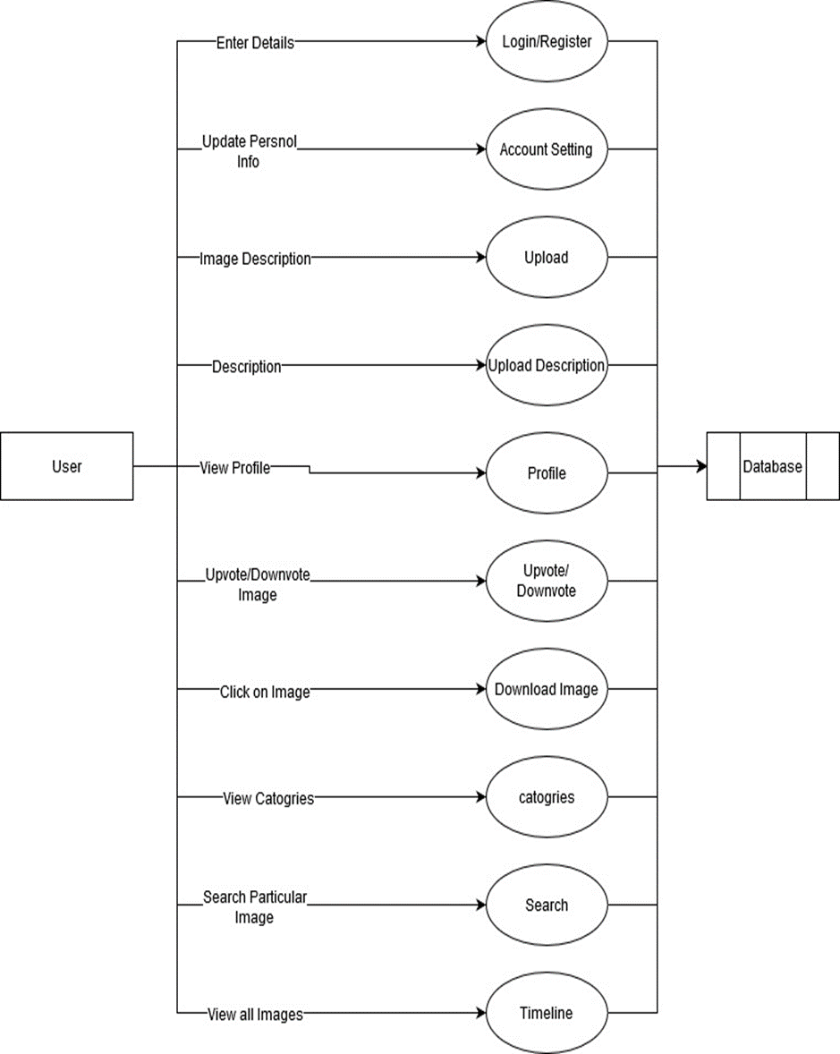
Data Flow Diagram (Level - 1)

Slide 11
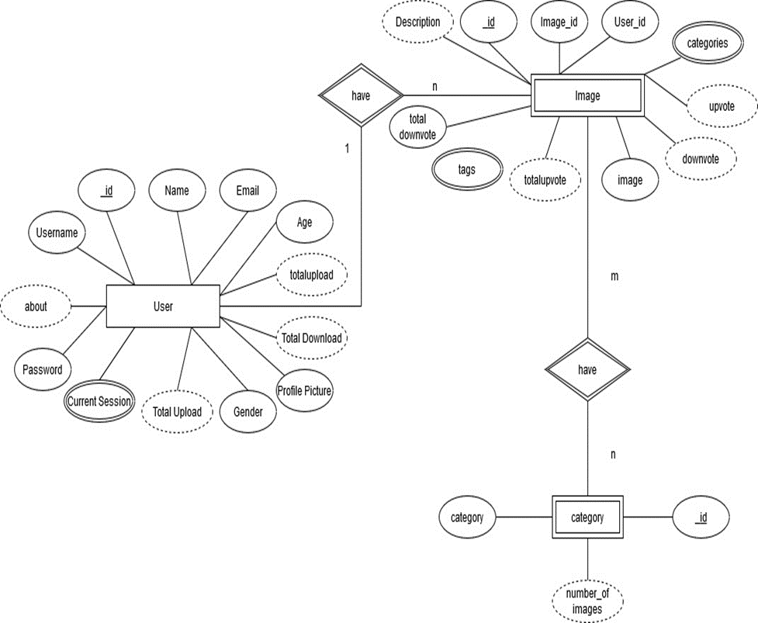
Entity-Relationship (E-R) Diagram

Slide 12
Screenshots

Slide 13
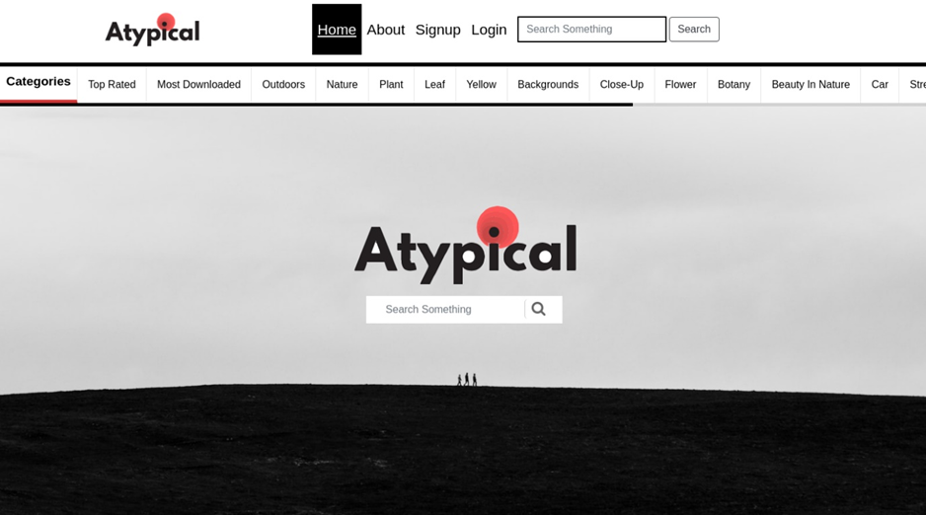
Screenshot - 1:

Slide 14
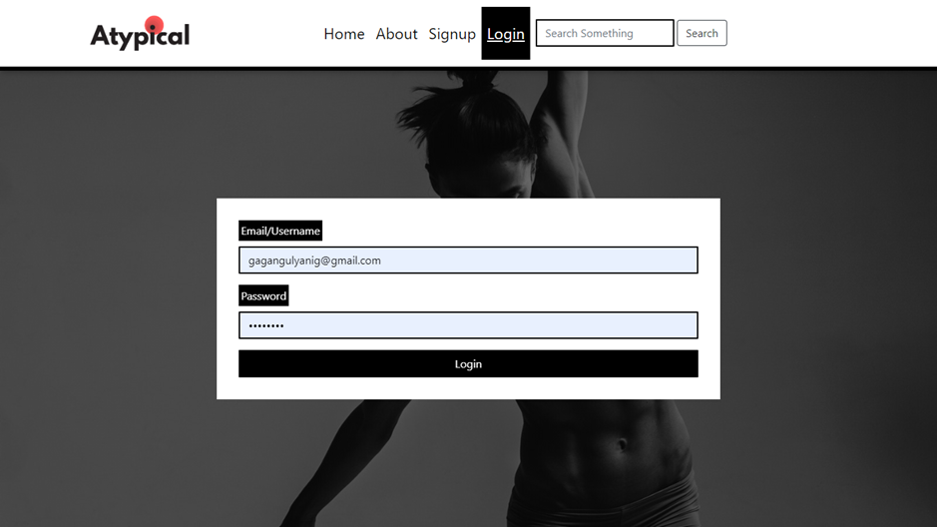
Screenshot - 2

Slide 15
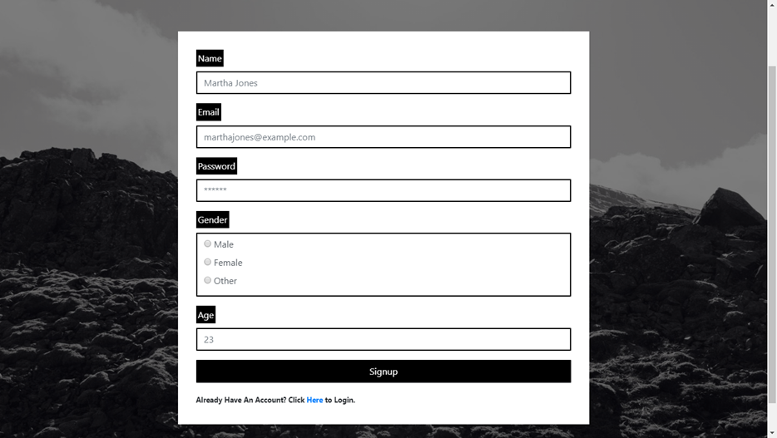
Screenshot - 3

Slide 16
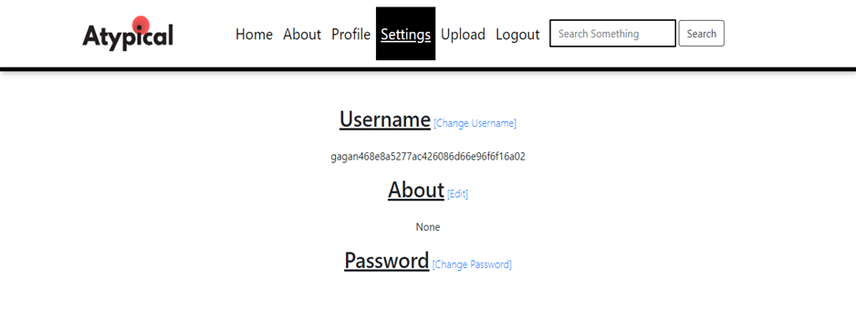
Screenshot - 4

Slide 17
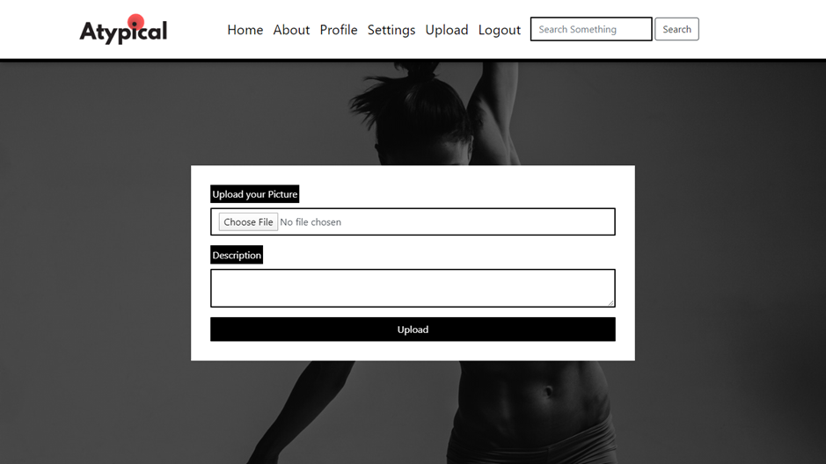
Screenshot - 5

Slide 18
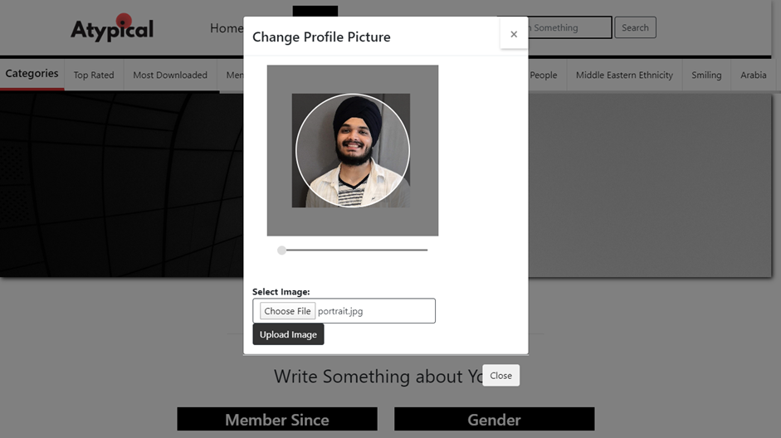
Screenshot -6

Slide 19
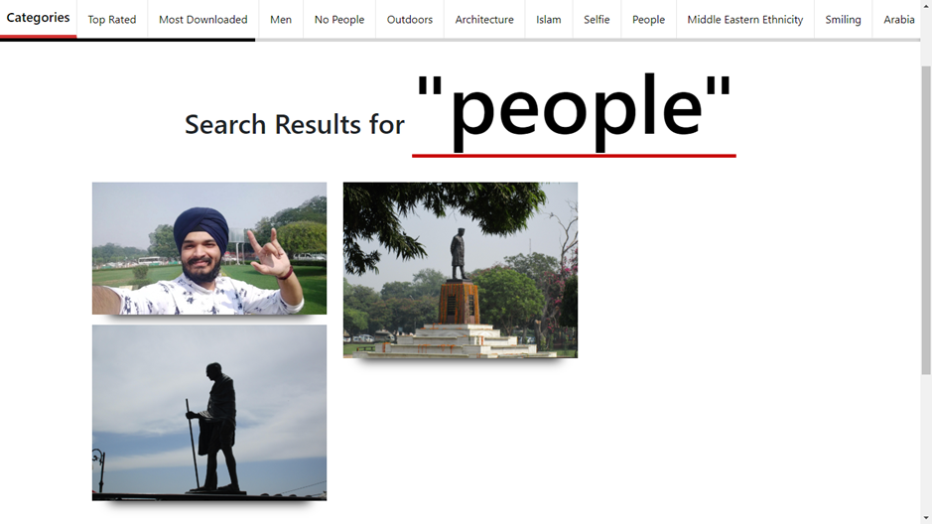
Screenshot-7

Slide 20
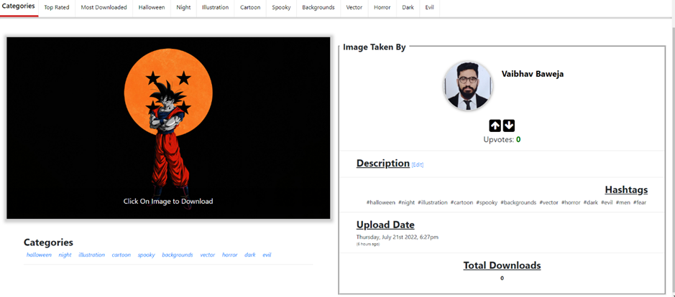
Screenshot -8

Slide 21
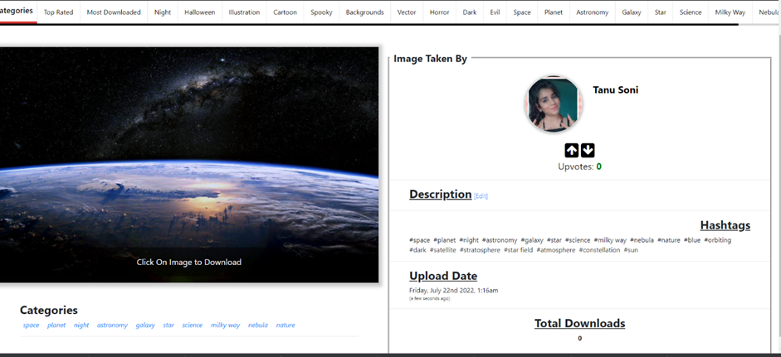
Screenshot-9

Slide 22
Testing of the Project
Testing & Debugging:
1. Unit Tests: Unit Tests have been made for assuring each and every component works as expected.
2. Integration Tests: Every component is Integrated then tested again for expected Output.
3. Regression Tests: As Agile Model is being followed for building Atypical, many new features have been applied as needed and these features are then tested. Then it is integrated with existing components and tested again for expected output.
Test Reports:
1. Web App is tested with different kinds of Inputs and Output is Observed to be expected.
2. Collections and Logs are constantly checked while debugging and testing to detect any bugs and anomalies in the process while either updating or removing existing components or adding a new component in Atypical.

Slide 23
Conclusion
Atypical is a Web App where Users can download pictures publicly for free without any hassle. It’s made for people like Graphic Designers, Artists, Content Creators who can search images which need in their work and can download them for free. Images can be posted by anyone after creating an account on Atypical by Signing up.
It’s clean and elegant design helps people to use it conveniently. People can find images by going through the Categories assigned right after the image is uploaded to the server.
Atypical’s responsiveness enables it to be platform independent which simply means Users can conveniently access the whole site with their Computers and Smart phones. Users can up-vote and down-vote images which they like or dislike for giving feedback to the person who uploaded

Slide 24
Future Scope
It still lags performance which is needed for is important when it comes to becoming a platform where large number of Users use the site. Algorithms for Storing and Retrieving data can be optimized.
Atypical also needs work on the User Interface as it is static, even though it uses JavaScript for loading for some processes but in order to be 100% responsive and Dynamic, it needs to use a Frontend Framework like ReactJS, AngularJS or VueJS.
The Image Compression algorithm and Categorization can be further optimized.
It can also be become a social media platform where Artists can connect to each other and send messages to each other. Atypical is made scalable so implementation of the features is possible.
Atypical can also be expanded furthermore for not just Stock Images but Videos, Music and Games too which are made available for everyone free of cost

Slide 25
Bibliography
Books:
E. Balaguruswamy, “Programming with C#.Net”, 4th ed., McGraw Hill Publication, 2016.
Book 2
Websites:
www.bvicam.in/index.html, [Accessed on 30 June, 2021].
Other Website

